Slide 1

State of
Plone backend
Maurits van Rees
Plone Release Manager
Py76
Notes:
I am Plone Release Manager for the backend.
I have my own company, Py76, where I work as freelancer.

Slide 2
Topics
Direction
Namespaces, setuptools, buildout
Core add-ons
Blicca page templates
Security support
The Netherlands

Slide 3
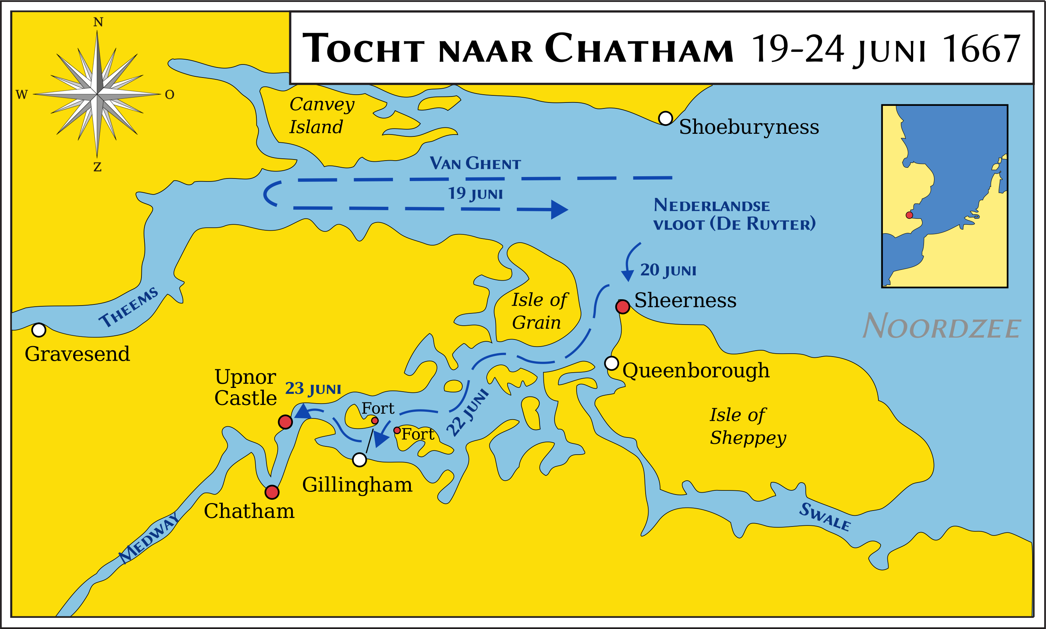
Wars with England
Notes:
In the beginning of the 17th century, the Netherlands reportedly had more ships sailing the oceans than all other European countries combined.
We also fought an 80 year war with Spain.
And we had three wars with England. We won two out of three.
Here is a map where the Dutch fleet sails straight into England.

Slide 4
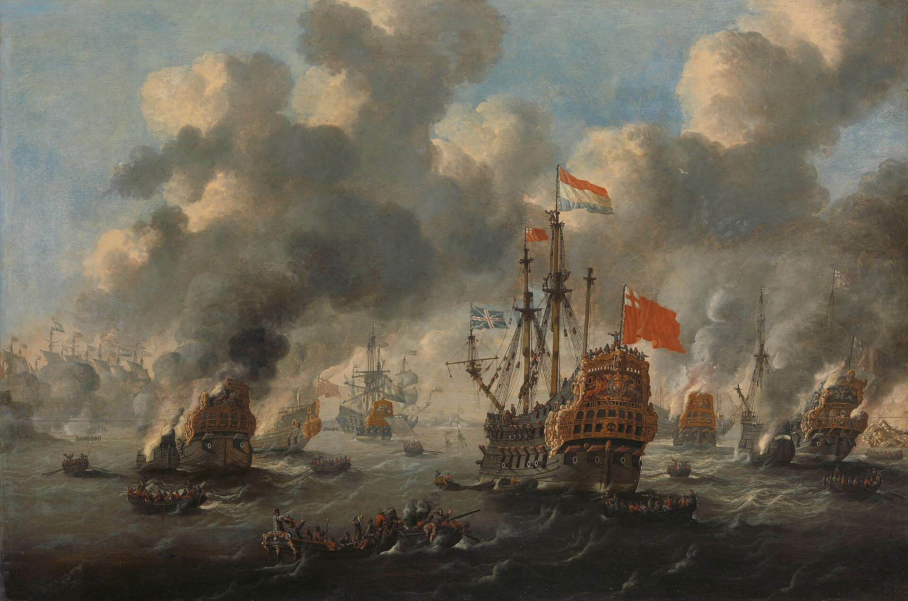
Wars with England
Notes:
Result: we burn the English fleet.
Don’t mess with the Dutch.

Slide 5
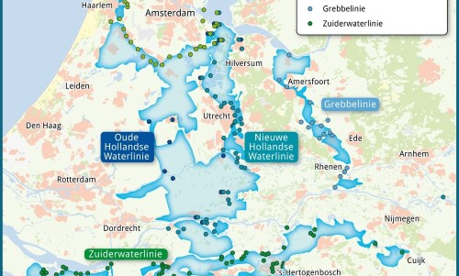
1672 “Rampjaar”
Notes:
The year of disaster.
Fighting mainly France, also England, Cologne, Münster.
You are Dutch, so what do you do? You flood your own country.
Good luck reaching Rotterdam, The Hague, Amsterdam.
Again, don’t mess with the Dutch.

Slide 6

Plone backend direction
Plone 6
Plone 7
Volto
Volto
Blicca
plone.restapi
plone.restapi
Classic UI
backend
backend
Notes:
From State of Plone keynote from three years ago. To understand changes made in 6.2 and planned for 6.3, you should look at the direction Plone is going to: the backend as a headless CMS. Currently the backend includes the Blicca (or Classic UI) frontend, and the Volto front-end sits on top of this. We are trying to untangle this.
Two lines of attack: move code and templates to a separate package; more "core add-ons”: make more code optional.

Slide 7
Plone 6.2 main changes
6.2.0 released 2026-05-19
Python 3.14 supported
Move to native namespaces
Start moving page templates to plone.app.layout
TinyMCE 8 for Classic UI

Slide 8
Plone 6.2 ongoing
Latest: 6.2.2
Add support for Python 3.15
Drop support for Python 3.10
Maybe reshuffling some ClassicUI / Blicca code
Notes:
6.2.2 released 2 weeks ago.

Slide 9
One more time: namespaces
6.2 core: from pkg_resources (setuptools) to native namespaces
Add-ons: please do the same
https://6.docs.plone.org/developer-guide/native-namespace.html
  Move code to src/ directory.
  setup.py: remove namespace_packages, packages, package_dir
  Remove __init__.py files that declare a namespace.
Actually can work on Plone 6.0 as well.
Notes:
On Plone 6.0 / 6.1: depends on your setuptools and zc.buildout versions.

Slide 10
Setuptools
81.0.0:
  2026-02-06
  last with pkg_resources
82.0.0
  2026-02-08
  pkg_resources removed

Slide 11
zc.buildout
zc.buildout 5 installs all namespaces as native
Developing: horse-with-no-namespace may help
Plone 6.2: use zc.buildout 5.2.0+
zc.buildout 6.0.0a1:
  vendorizes pkg_resources: works with setuptools 82+ too ❤️icemac
  Editable non-setuptools projects work: hatchling, flit, pdm ❤️erral
Plone 7: likely no zc.buildout
Notes:
zc.buildout is similar to pip: site-packages/plone/ does not contain __init__.py files that declare namespaces.

Slide 12
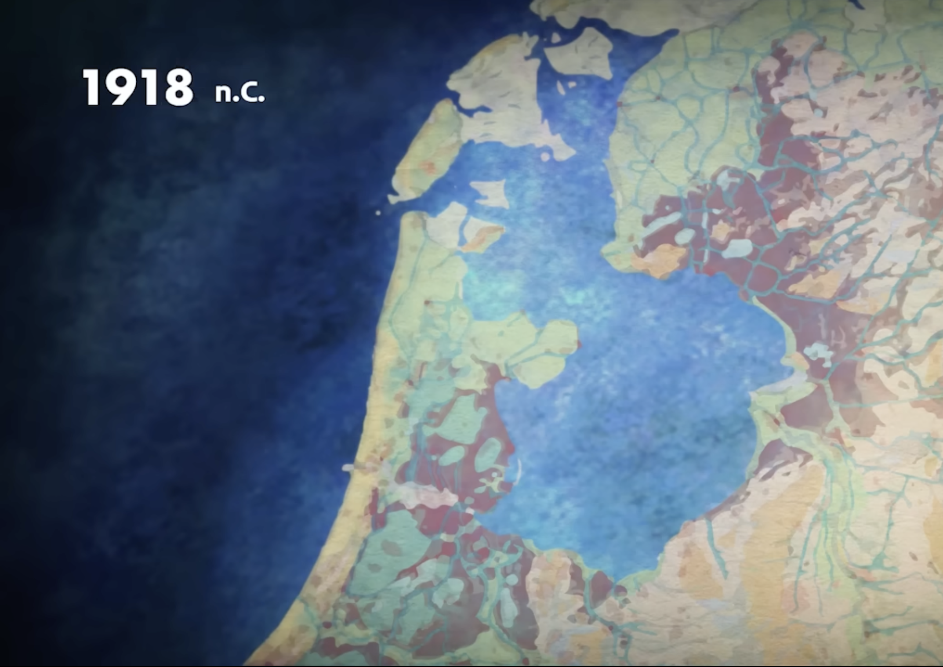
Zuiderzee

Slide 13
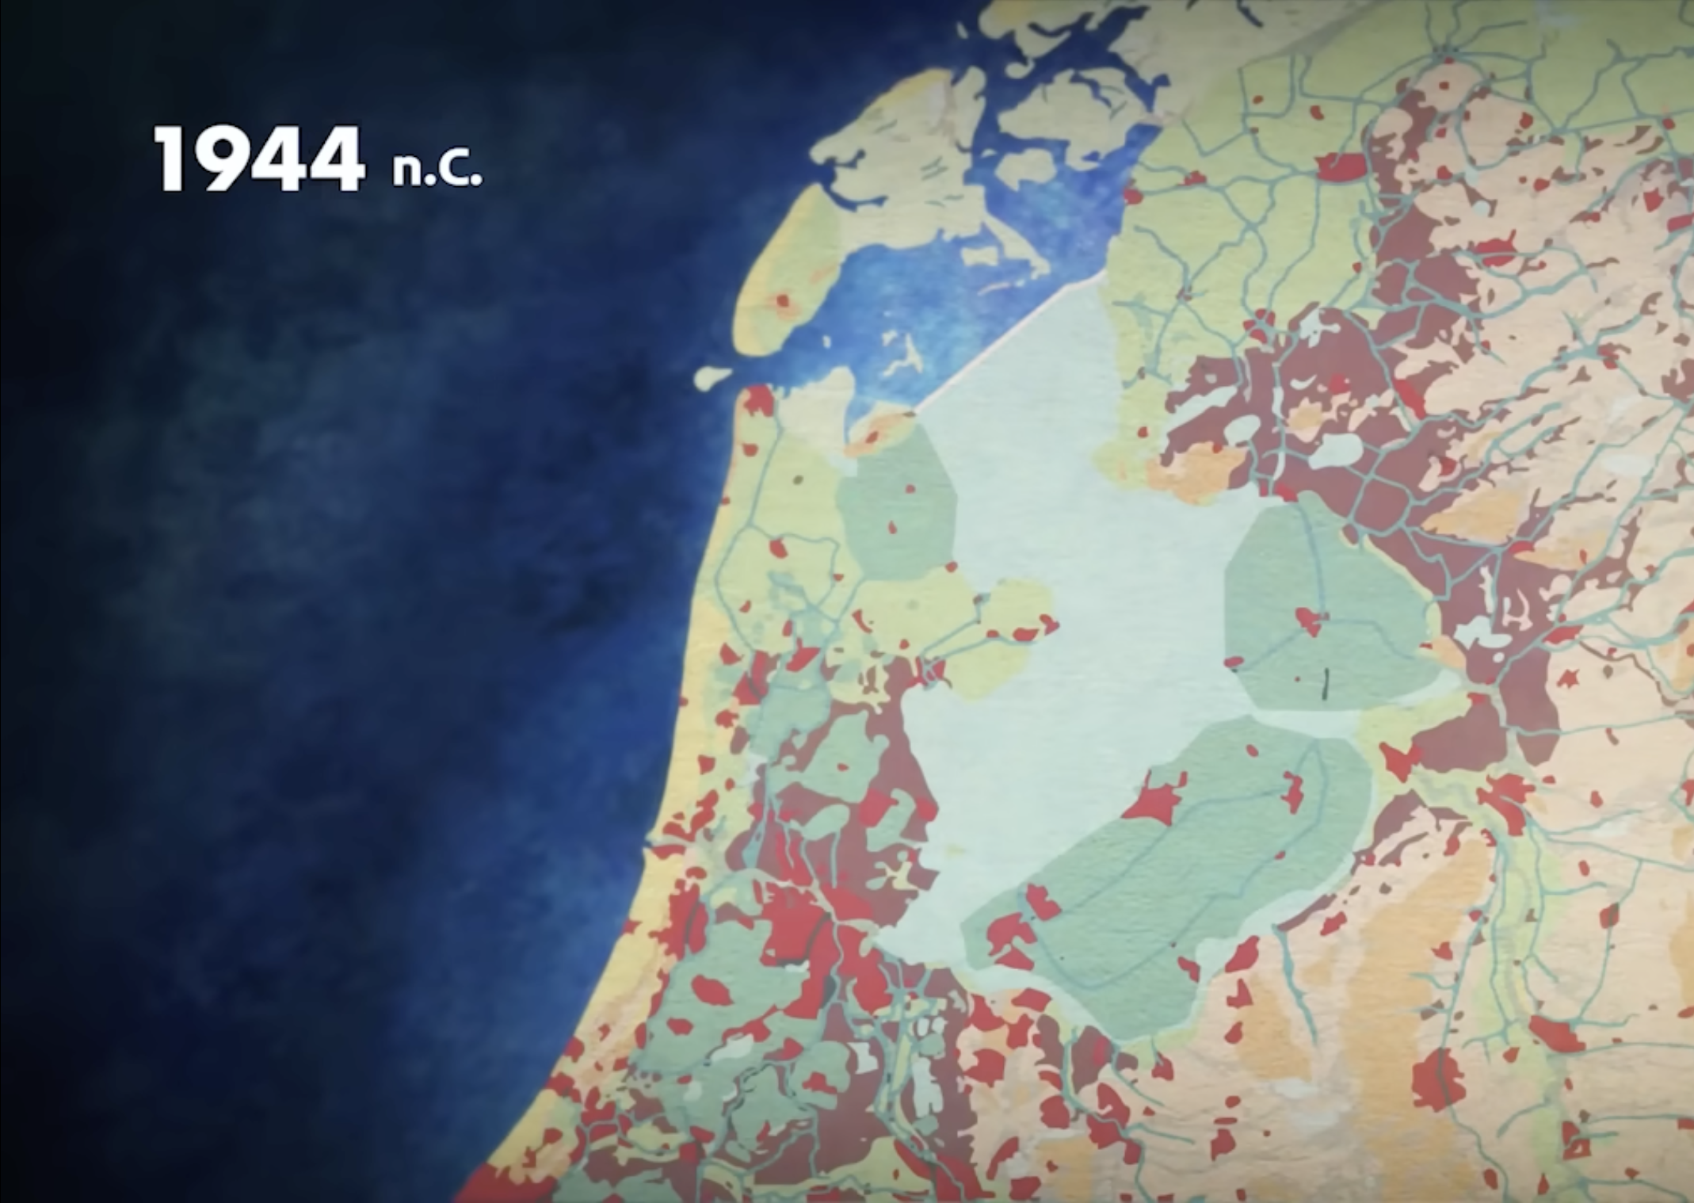
IJsselmeer

Slide 14
More Blicca page templates optional
Goals:
  Volto does not use page templates: remove unneeded code.
  Move more remaining templates together, for easier finding.
Move page templates to plone.app.layout. 6.2:
  plone.locking / plone.protect
Plone 6: CMFPlone depends on plone.app.layout
Plone 7:
  plone.app.layout depends on CMFPlone
  plone.classicui depends on plone.app.layout
Notes:
In Plone 6 you always get the plone.app.layout package.
But this now has an optional GenericSetup profile, and this is installed by plone.classicui.
The more we move in 6.3 in a backwards compatible way, the less we need to do in 7.0.

Slide 15
6.3: More core add-ons
plone.app.customerize (portal_view_customizations)
contentrules
portlets:
  plone.app.portlets
  plone.portlets
  plone.portlet.collection
  plone.portlet.static
  plone.app.event: event and calendar portlets
  all in one package?
Notes:
Volto does not need portlets.

Slide 16

Recycle bin
Sorry Rohan!
Thank you David!
https://github.com/plone/Products.CMFPlone/issues/2966

Slide 17
Discussion improvements
Sorry Rohan!
Improve comment moderation UI
word-based content filtering (spam detection)
User ban management
https://github.com/plone/Products.CMFPlone/issues/4187

Slide 18
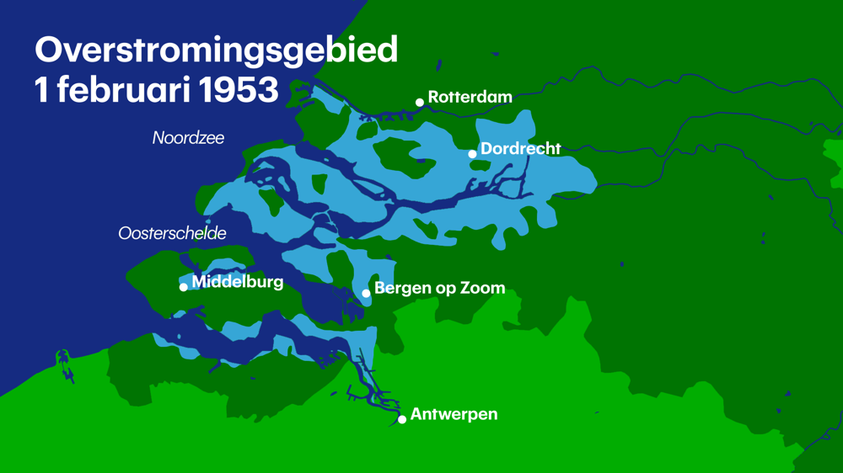
1953 water flood
Notes:
1836 dead in The Netherlands, plus a few hundred in England and Belgium.

Slide 19
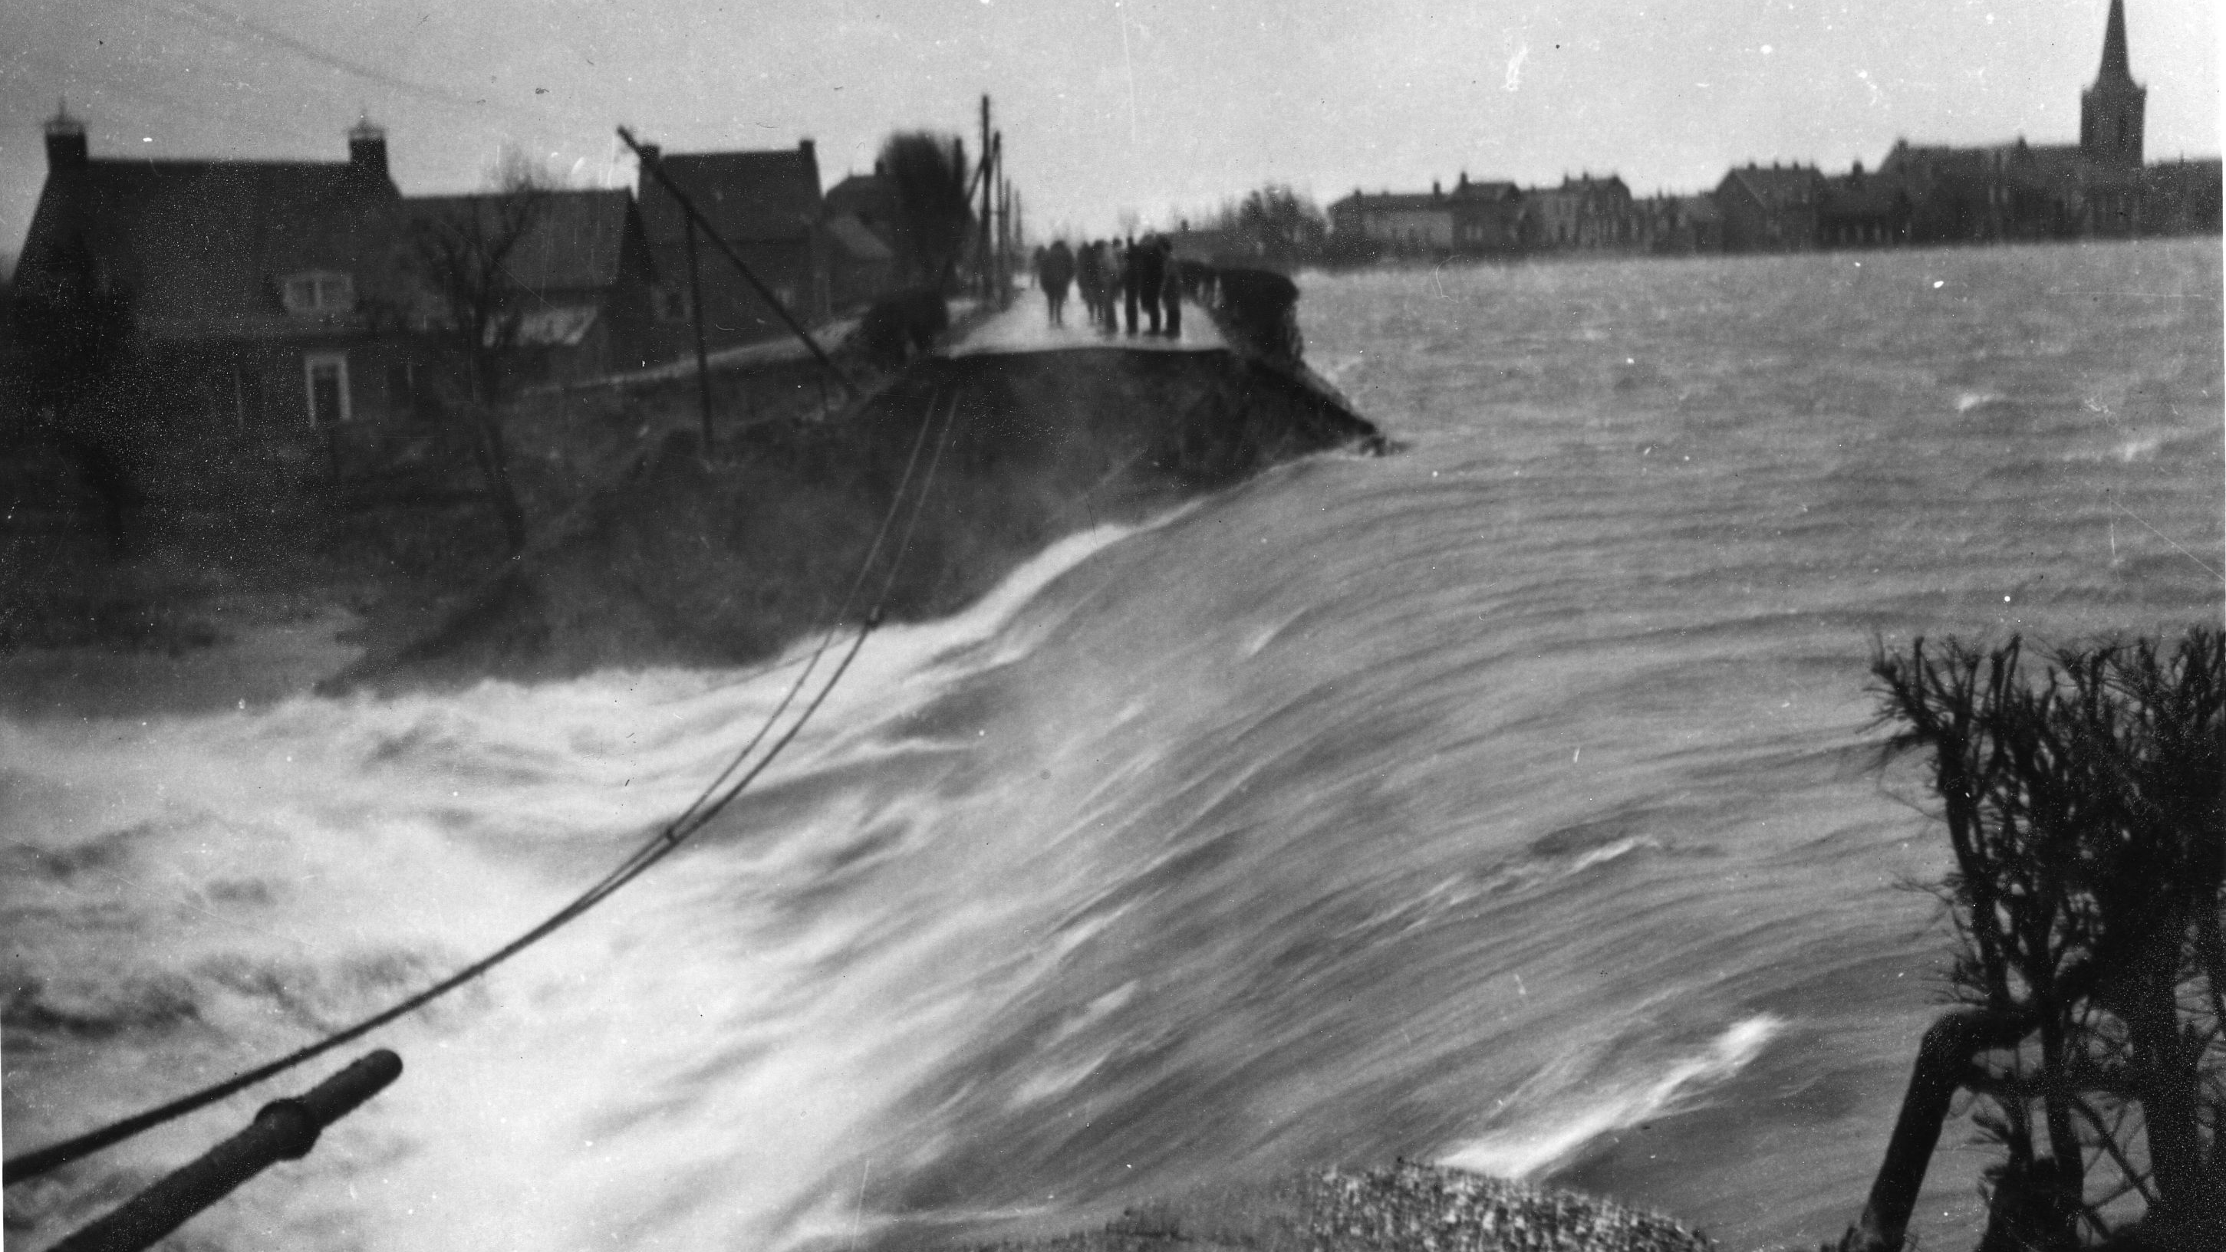

Slide 20
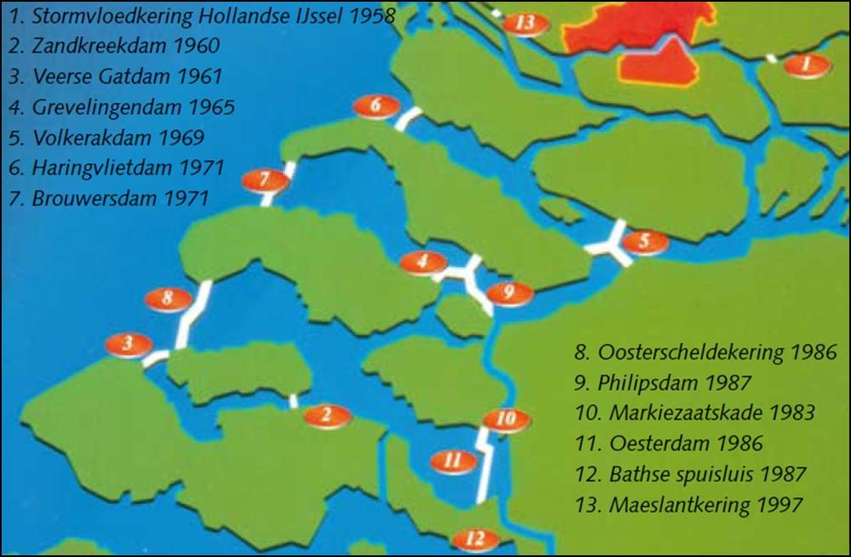
Delta works

Slide 21

Delta works
Oosterschelde kering (barrier)

Slide 22
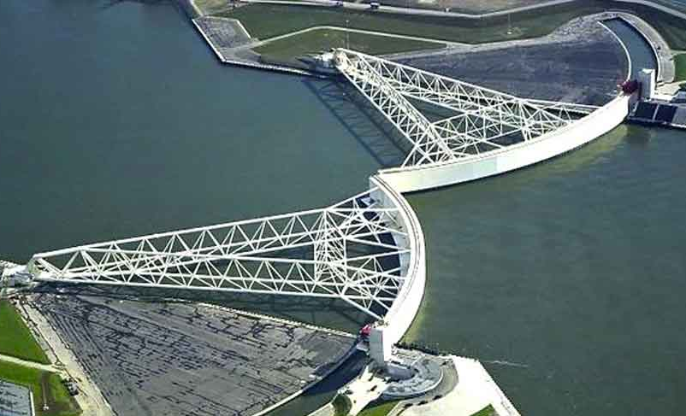
Maeslant kering/barrier

Slide 23
Security support
All Plone 6 minor versions get security support until 2027-12-31.
6.3.0: mid 2027?
7.0.0: mid 2028?
6.0, 6.1: security until 2027-12-31
6.2: security until 7.0.0 (~2028-06-30)
6.3: security until 7.0.0 + 1 year (~2029-06-30)
Notes:
The Dutch take security seriously. So does Plone.
For Plone 6.0, this includes Volto 16.

Slide 24
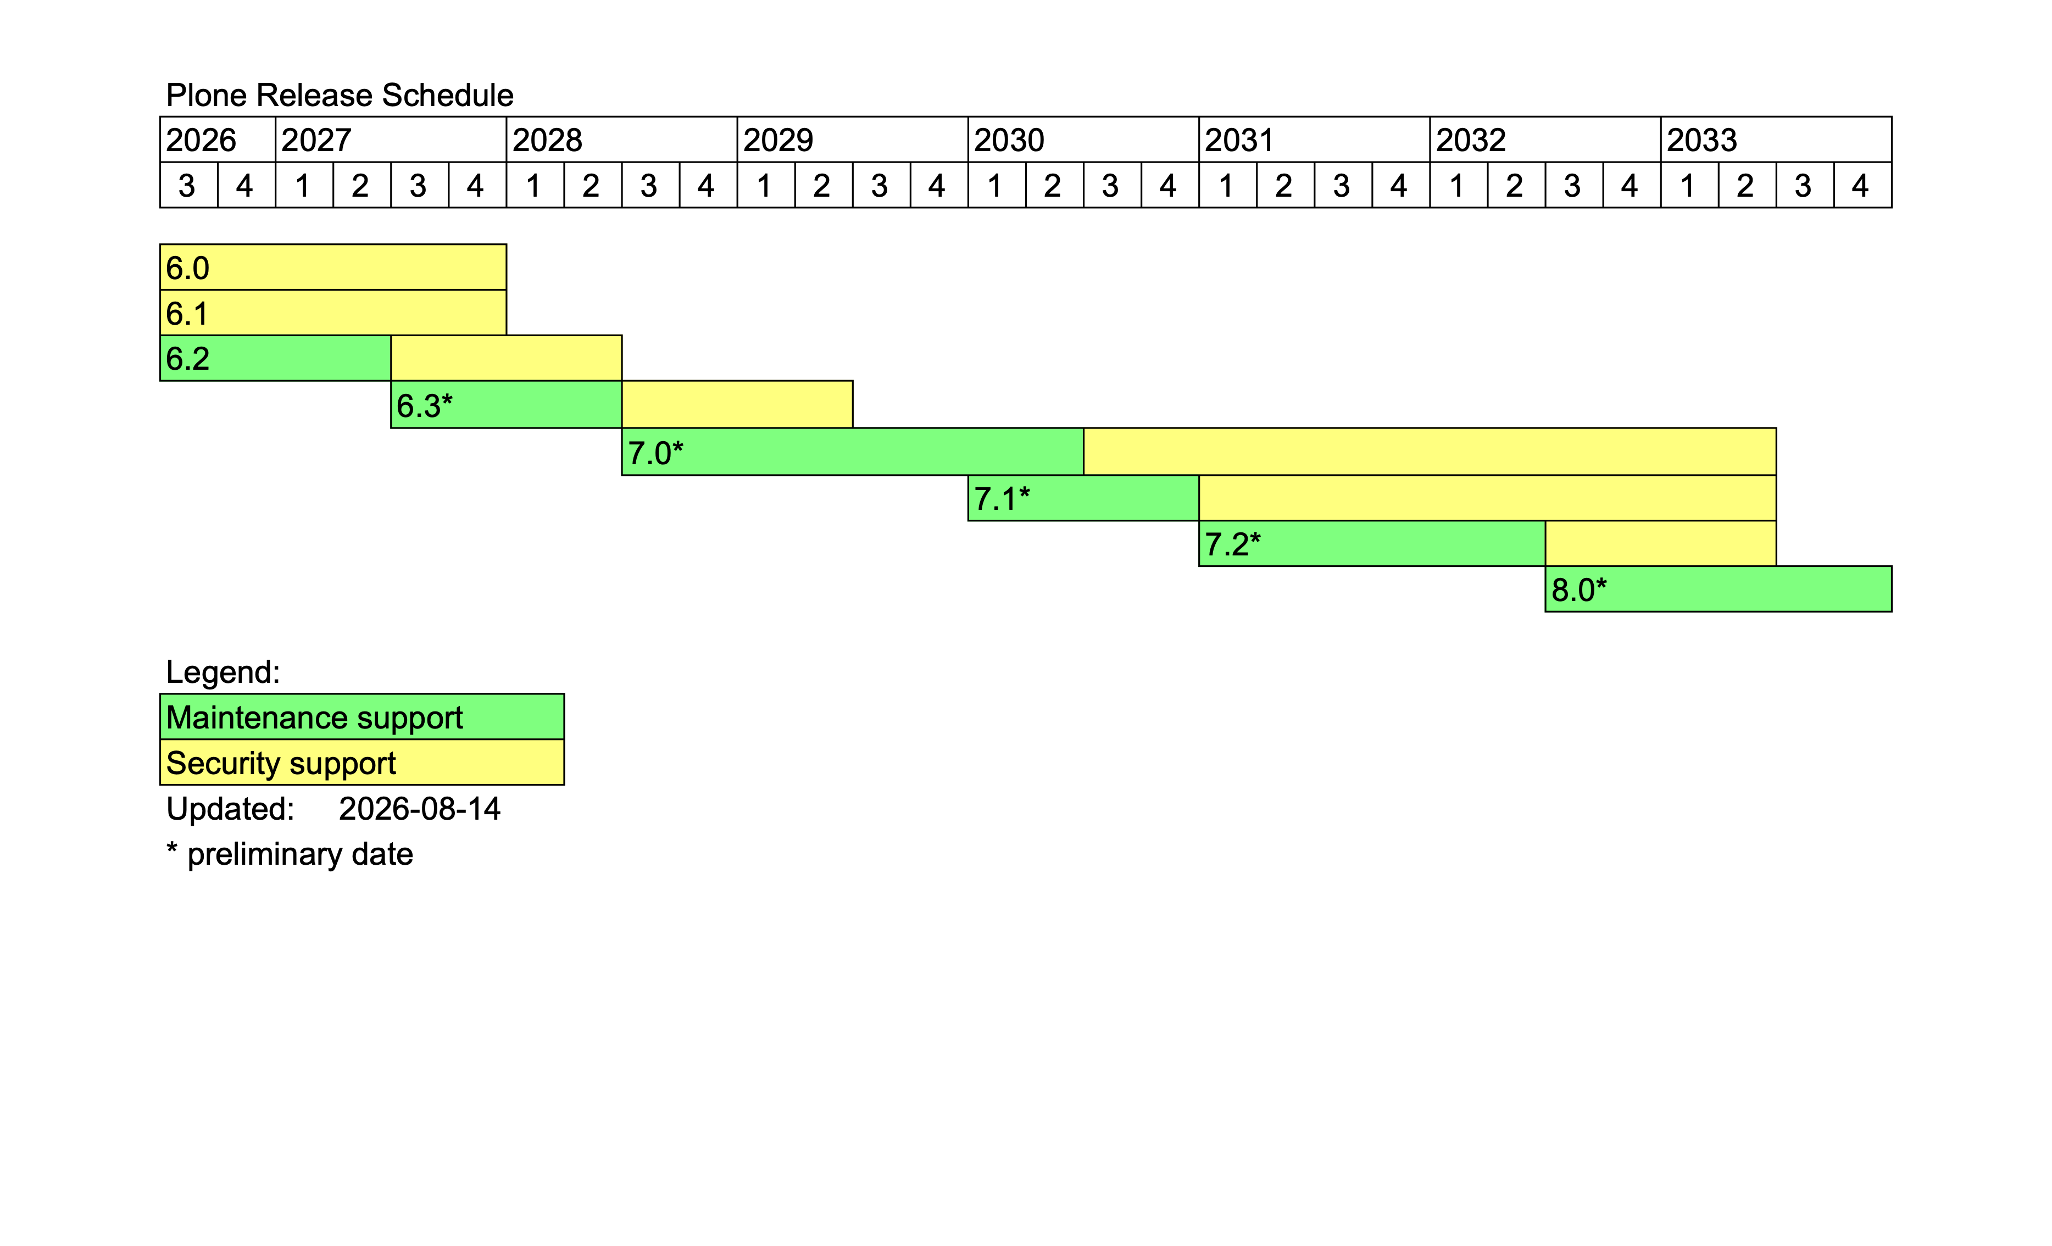
Release schedule

Slide 25

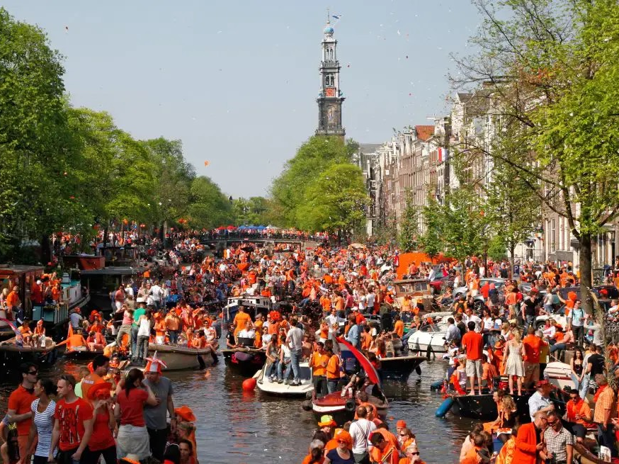

Questions?
https://plone.org/download/release-schedule
https://maurits.vanrees.org
https://py76.be

