Slide 1

Deploy multiple Volto sites with one backend
Maurits van Rees
Plone Release Manager
Py76
Notes:
I am Plone Release Manager for the backend.
I have my own company, Py76, where I work as freelancer.

Slide 2




Notes:
You may have a friend who asks if you can make a small website for his bakery. Or your sports club or church is using Wordpress or some ugly site builder, or some overpriced and overpromising solution.

Slide 3
Friends don’t let friends use WordPress / Wix
Notes:
You know what you need to do: use Plone.
But isn't Plone overkill for such small sites? Don't you need a bit too many Docker images and complex GitHub Actions workflows? No.

Slide 4
Strategy
Cookieplone project
One backend with multiple Plone Sites
Multiple Volto frontend containers
GitHub Actions generate Docker images
Deploy using local commands

Slide 5
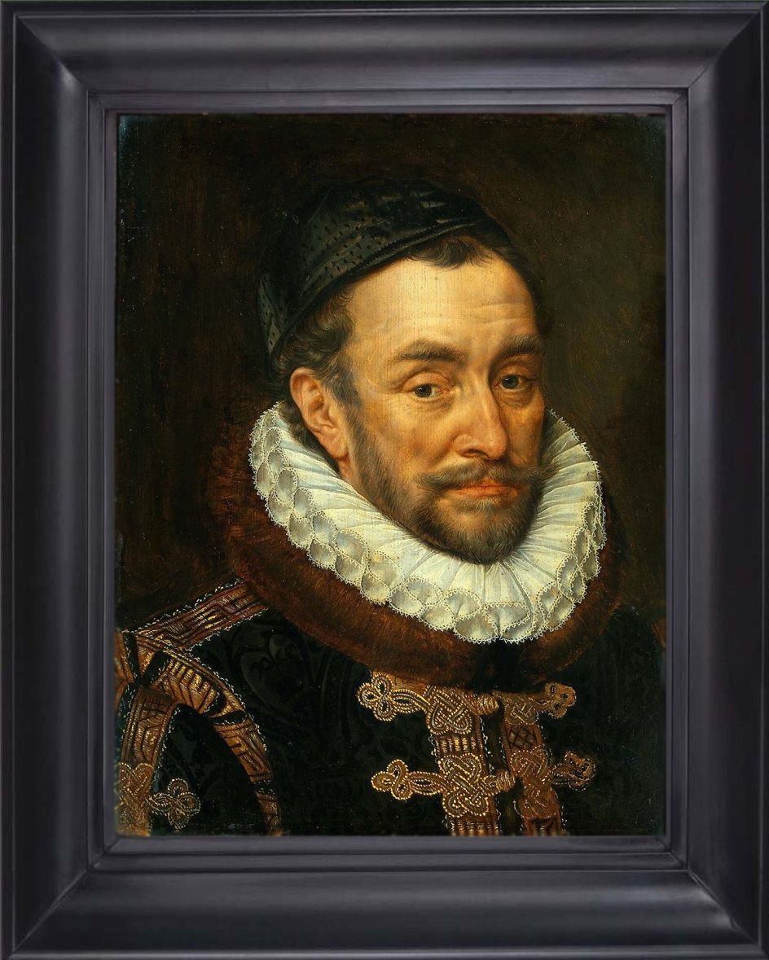

The house of Orange
1568 - 1648: war with Spain
1584: Willem van Nassau assassinated
1600: Battle of Nieuwpoort, prins Maurits

Slide 6
cookieplone
uvx cookieplone project
Probably skip: caching, documentation (Storybook)

Slide 7
Backend
scripts/create_site.py:
SITE_ID = os.getenv("SITE_ID", "")
sites = [SITE_ID] if SITE_ID else (
"Plone", "artmirror", "sintniklaas")
for site_id in sites: …

Slide 8
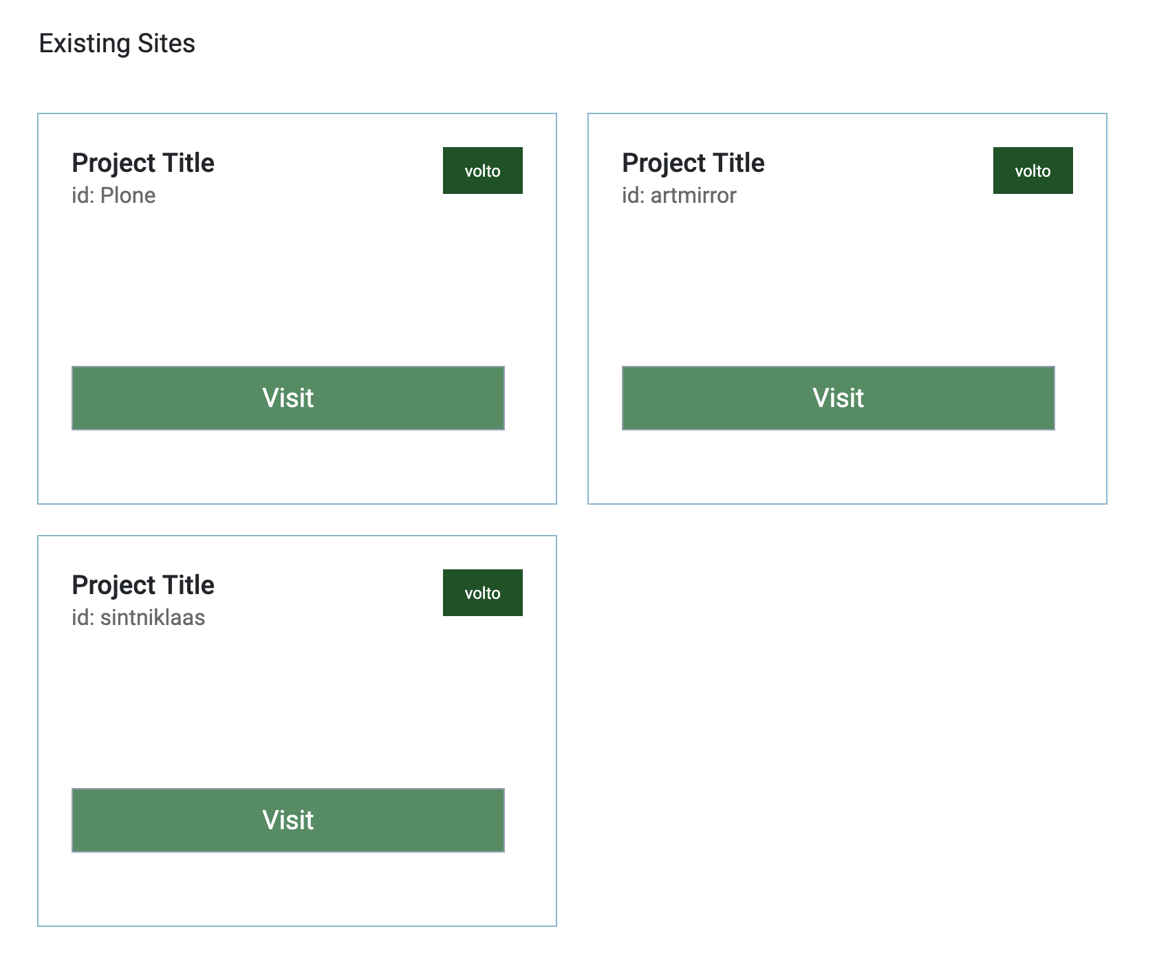

Slide 9

make frontend-start

Slide 10
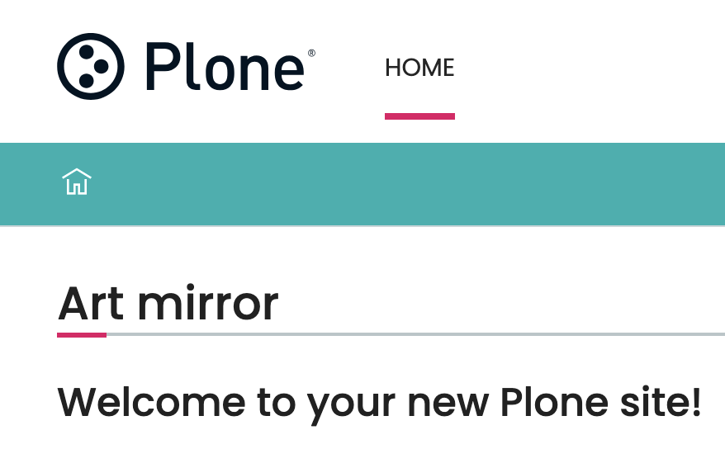
RAZZLE_INTERNAL_API_PATH=http://localhost:8080/artmirror make frontend-start

Slide 11
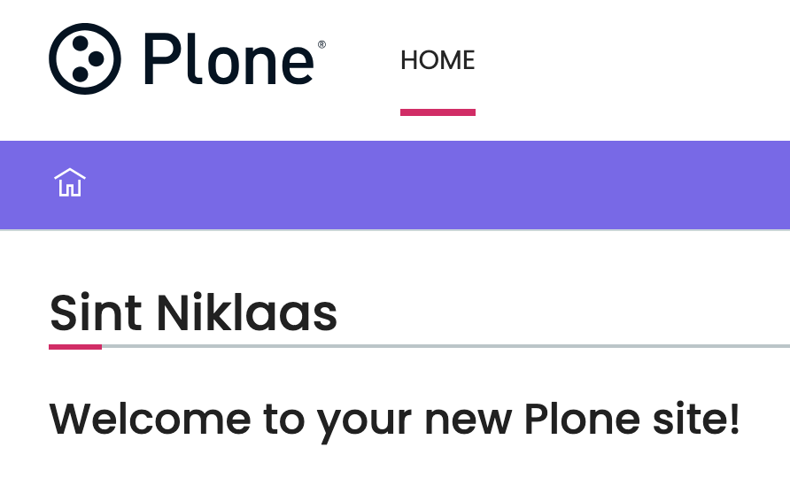
RAZZLE_INTERNAL_API_PATH=http://localhost:8080/sintniklaas make frontend-start

Slide 12
Add body class with site id
from plone.base.interfaces import IPloneSiteRoot
from plone.restapi.interfaces import ISiteEndpointExpander
from zope.component import adapter
from zope.interface import implementer, Interface
@implementer(ISiteEndpointExpander)
@adapter(IPloneSiteRoot, Interface)
class SiteId:
def __init__(self, context, request):
self.context = context
self.request = request
def __call__(self, result):
result["site_id"] = self.context.getId()
return result

Slide 13
customizations/components/theme/App/App.jsx
export class App extends Component {
…
// extra:
const site_id = this.props.GET_SITE.site_id;
…
<BodyClass className={`view-${action}view`} />
// extra:
<BodyClass className={`siteid-${site_id}`} />

Slide 14
theme/extras/custom.less
body.siteid-Plone #footer {
background-color: lightgreen !important;
}
body.siteid-artmirror #footer {
background-color: #563187 !important;
}
body.siteid-sintniklaas #footer {
background-color: lightsalmon !important;
}

Slide 15


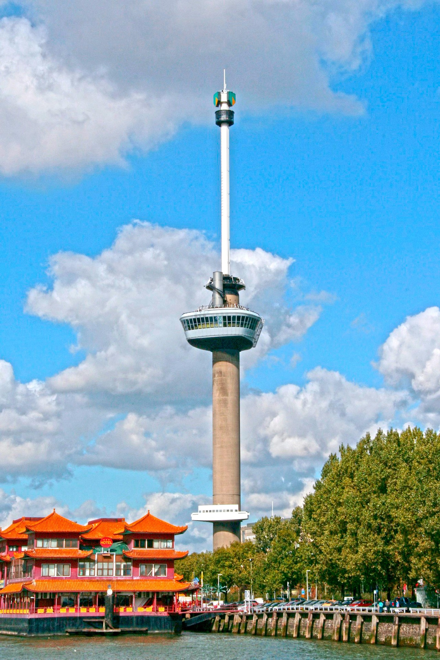

Rotterdam
Notes:
Maastricht has the river Maas, Rotterdam has the New Maas.
Amsterdam has it, Rotterdam does not need it.

Slide 16
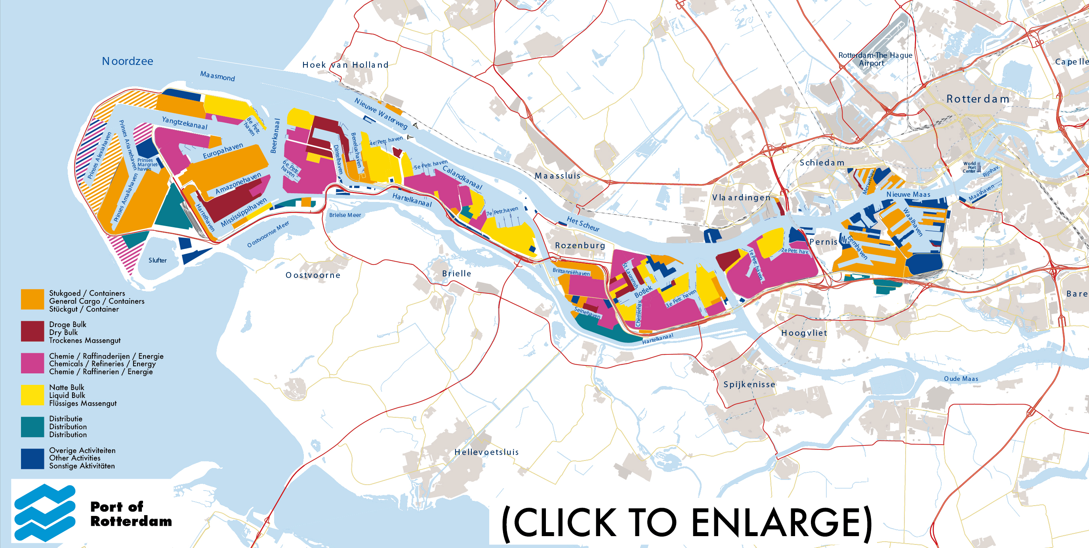

Slide 17
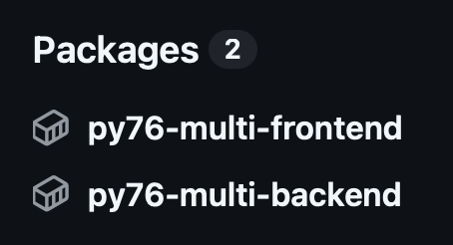
GitHub Actions
Two Docker images

Slide 18
Server setup
cd devops; make setup; make server-setup; etc
fresh server, Ubuntu 24
make deploy
  First time: comment out everything except Traefik and db
  Then enable backend as well
  Then everything

Slide 19
Services
$ make stack-status
traefik.1 traefik:v3.7
db.1 postgres:18
backend.1 ghcr.io/py76be/py76-multi-backend:latest
frontend.1 ghcr.io/py76be/py76-multi-frontend:latest
artmirror.1 ghcr.io/py76be/py76-multi-frontend:latest
sintniklaas.1 ghcr.io/py76be/py76-multi-frontend:latest
Notes:
Important: ONE frontend image

Slide 20
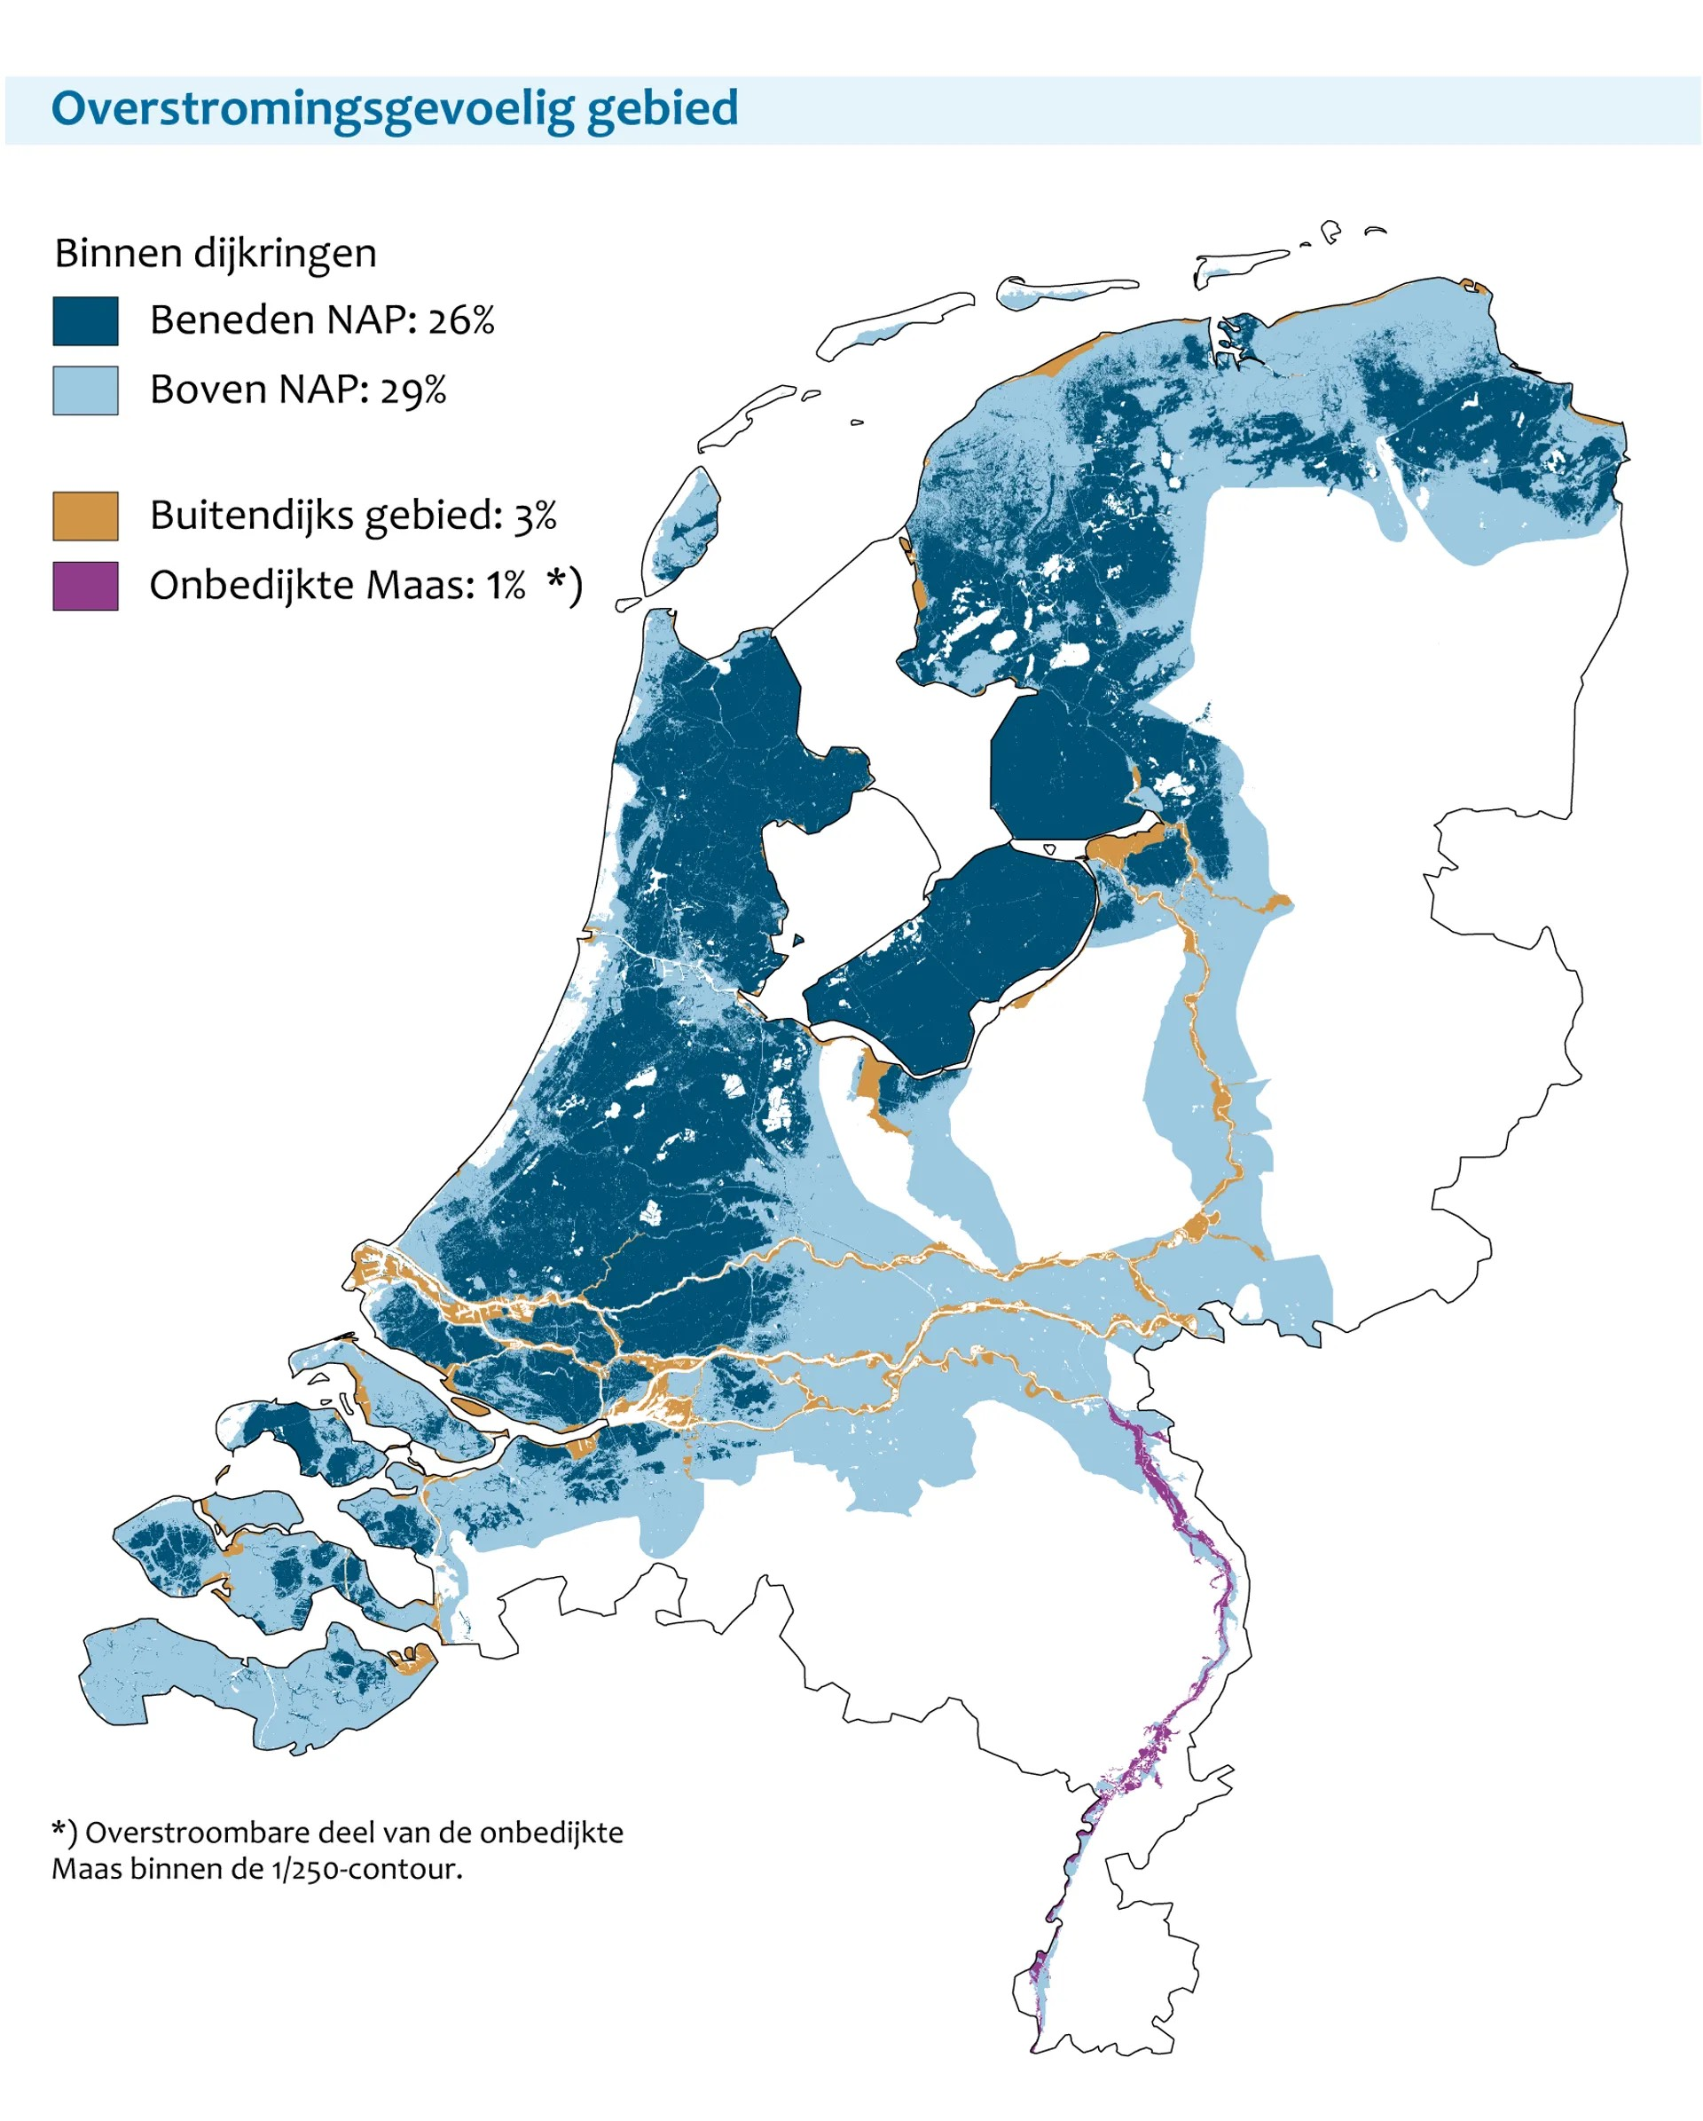

Notes:
The top of the picture on the right is at sea level.
Lowest point is almost minus 7 meters.

Slide 21
devops/stacks frontend
frontend:
image: ghcr.io/py76be/py76-multi-frontend:latest
environment:
RAZZLE_INTERNAL_API_PATH: http://backend:8080/Plone
RAZZLE_API_PATH: https://multi.py76.be
labels:
- traefik.http.routers.rt-
frontend.rule=Host(`multi.py76.be`)
artmirror:…
sintniklaas:…

Slide 22
Traefik routing
multi.py76.be -> frontend:3000
multi.py76.be/++api++ -> backend:8080/Plone/++api++
multi.py76.be/Root -> backend:8080/
artmirror.py76.be -> artmirror:3000
sintniklaas.py76.be/++api++
-> backend:8080/sintniklaas/++api++

Slide 23
devops/stacks backend
backend:
labels:
- traefik.http.routers.rt-backend-api
.rule=Host(`multi.py76.be`) && PathPrefix(`/++api++`)
- traefik.http.routers.rt-backend-api
.middlewares=mw-backend-vhm-api
- "traefik.http.middlewares.mw-backend-vhm-api
.replacepathregex
.regex=^/\\+\\+api\\+\\+($$|/.*)"
- "traefik.http.middlewares.mw-backend-vhm-api.replacepathregex
.replacement=/VirtualHostBase/https/multi.py76.be/Plone/++api++/VirtualHostRoot$$1"

Slide 24
devops/stacks backend
backend:
labels:
- traefik.http.routers.rt-backend-api.rule=Host(`multi.py76.be`) && PathPrefix(`/++api++`)
- traefik.http.routers.rt-backend-api.middlewares=mw-backend-vhm-api
- "traefik.http.middlewares.mw-backend-vhm-api.replacepathregex
.regex=^/\\+\\+api\\+\\+($$|/.*)"
- "traefik.http.middlewares.mw-backend-vhm-api.replacepathregex
.replacement=/VirtualHostBase/https/multi.py76.be/Plone/++api++/VirtualHostRoot$$1”
- traefik.http.routers.rt-backend-artmirror-api.rule=Host(`artmirror.py76.be`) && PathPrefix(`/++api++`)
- traefik.http.routers.rt-backend-artmirror-api.middlewares=mw-backend-artmirror-vhm-api
- “traefik.http.middlewares.mw-backend-artmirror-vhm-api.replacepathregex
.regex=^/\\+\\+api\\+\\+($$|/.*)"
- "traefik.http.middlewares.mw-backend-artmirror-vhm-api.replacepathregex
.replacement=/VirtualHostBase/https/artmirror.py76.be/artmirror/++api++/VirtualHostRoot$$1"
Notes:
On top is the same config as on the previous slide.
Below is the same for artmirror.

Slide 25
devops/stacks /Root
- "traefik.http.middlewares.mw-backend-vhm-root.replacepathregex.regex=^/Root($$|/.*)"
- "traefik.http.middlewares.mw-backend-vhm-root.replacepathregex.replacement=/VirtualHostBase/https/multi.py76.be/VirtualHostRoot/_vh_Root$$1"

Slide 26

Questions?
https://maurits.vanrees.org
https://py76.be
stroopwafels

